Slide 1


Accelerating Incident Response
Project Members Ekansh Thakur 21bcs037
Jaishana Bindhu Priya 21bcs045
Kshitiz Sachan 21bcs057

Slide 2
What and why care about incident response ?
What is incident response
Influences an organizations final cost of breach.
Average time to identify and contain a breach was 277 days (204+73) (IBM 2023)

Slide 3
About the paper
(2024) Accelerating Incident Response: Applying Confidence Aggregation to Defensive Artifacts. SANS.edu. Retrieved from SANS Research Paper.
A tool/methodology to help cybersecurity personnel make quick decisions.

Slide 4
Methodology
Used cyber threat emulation. (not actual but similar tools)
APT 29, Wizard Spider. (2months)
Windows 7, 10, a router, an email server, domain controllers(x2)
Collected artifacts, analyze them, make a scoring system.
Use this with your organization tools and use the data gathered for incident response or designing heuristics.

Slide 5
APT 29
Russian Foreign Intelligence Service
Targets: Foreign Military, institutions
Attack Pattern
Phase 1: Watering hole attack -> remote access
Malicious doc in webpage, executes payload, creates reverse shell to C2
Phase 2: Collection, lateral movement, long term persistence
Establishing persistence, stealing credentials, Sea-Duke.

Slide 6
Wizard spider
Russian based threat group
Targets: Major corporations and hospitals
Attack Pattern
Phase 1: Phishing attack (spear phishing) using infected doc
Phase 2: Emotet opens SSH tunnel for remote desktop backdoor, scrapes credentials,
Trickbot performs network discovery, lateral movement, steal AES Hashes.
Phase 3: Deploy Ryuk to DC

Slide 7
ARTIFACT COLLECTION AND ANALYSIS
Suricata, Sysmon, Windows Event Logs and Zeek logs.
Suricata + Zeek -> span port
Sysmon + WindowsEL -> Beats to Security Onion Collector
Pcap captures at firewall -> analysed every 24hrs by a team

Slide 8
MITRE Techniques considered
Reconnaissance, Resource development scraped.
Collection, Command and control, Exfiltration and Impact scraped.
Considered: Initial access, execution, persistence, privilege escalation, defense evasion, credential access, discovery, lateral movement.

Slide 9
Tool Assessment
Availability, Reliability, Location
Availability -> Tools o/p + availability at execution
Reliability -> wrt organization compatibility
Location -> host based, network based
Confidence Rating: 1 to 3

Slide 10
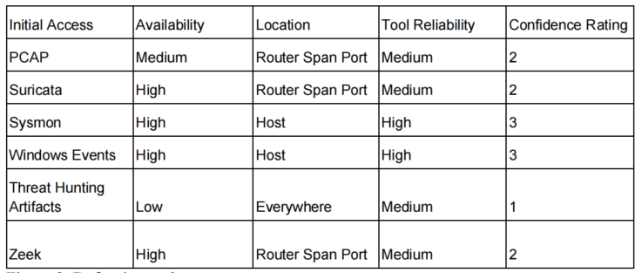
Defensive tool assessment total

Slide 11

Signatures and artifacts given an assessment total

Slide 12
Total confidence multiplier
Applied to the artifacts found each day within the categories.
Tool Saturation: The more tools that identify the same signature, the higher the rating.
False Positive
Threat Intelligence: How likely is it associated with a threat and how dangerous.(history)

Slide 13
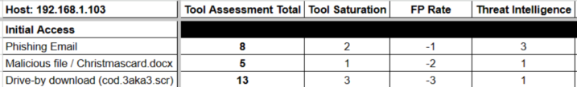
Total confidence multiplier

Slide 14
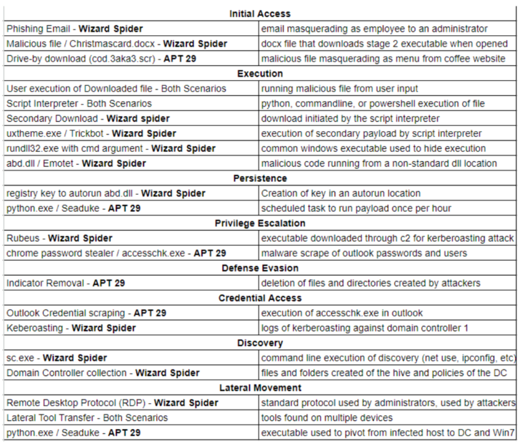
Artifacts labelled

Slide 15
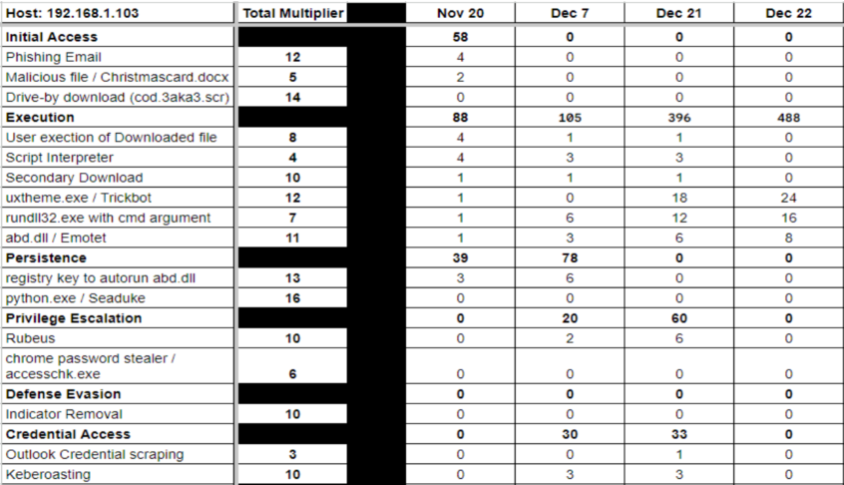
FINAL Tactic totals

Slide 16
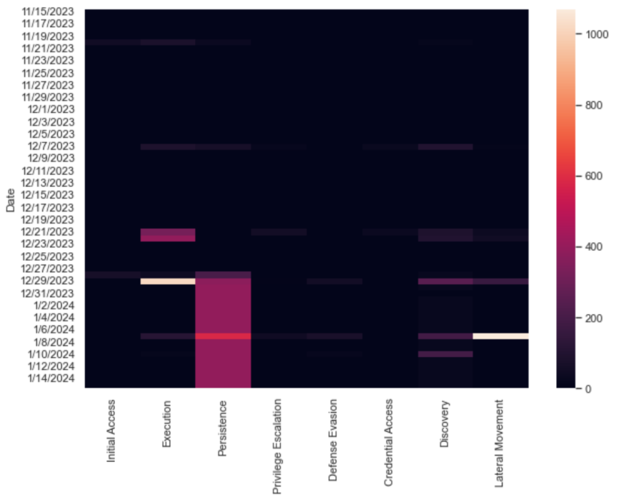
Confidence heatmap

Slide 17
Enhancing Tool Evaluation

Slide 18
ENHANCING TOOL EVALUATION
The original research paper’s framework assesses detection tools, but it may lack certain dimensions that reflect real-world use.
Enhance the robustness and reliability of tool evaluation by introducing new metrics.
Adding more metrics to the Tool Assessment.
False Positive Rate(FPR) and Mean Time To Detect(MTTD)

Slide 19
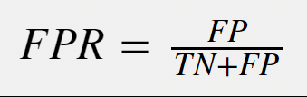
False POSITIVE RATE (FPR)
False Positive Rate (FPR) measures the proportion of benign events or activities incorrectly identified as threats by the detection system.

Slide 20
WHY FPR?
Improved Tool Selection: FPR adds an essential dimension of reliability in tool selection, enabling a balance between detection accuracy and minimizing unnecessary alerts.
According to the Journal of Cybersecurity (2020), false positives in intrusion detection systems (IDS) lead to reduced trust in the system and decreased operational productivity due to continuous manual reviews.

Slide 21
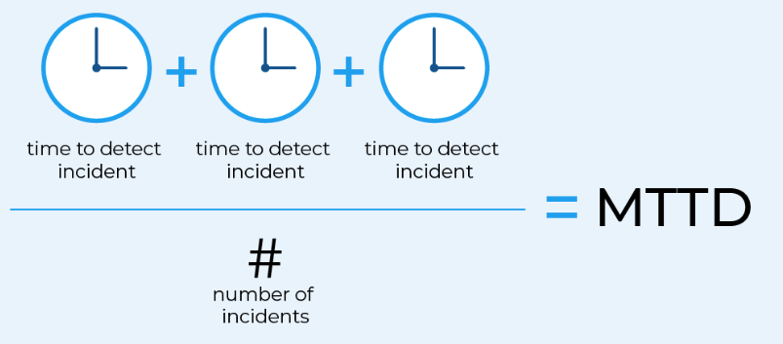
Mean Time to detect (MTTD)
Mean Time to Detect (MTTD) refers to the average time it takes for a detection system to identify a potential security threat after it occurs.

Slide 22
WHY MTTD?
Operational Efficiency: MTTD is critical for tools used in real-time monitoring systems, where speed of detection can significantly influence the severity of the attack’s impact.
Risk Mitigation: Rapid detection minimizes the "dwell time" of an attacker in the network, which can greatly reduce the likelihood of data loss or system compromise.
In the paper "Optimizing Security Operations with Rapid Detection and Response" (2020), it was demonstrated that reducing MTTD can significantly cut the average time an attacker remains undetected, lowering the chances of a full-blown breach.

Slide 23
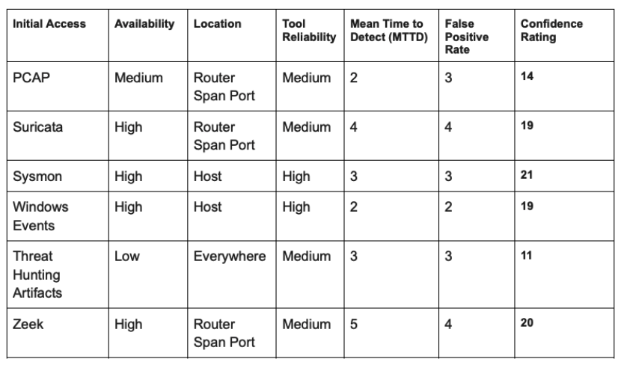
Updated Defensive tool assessment

Slide 24
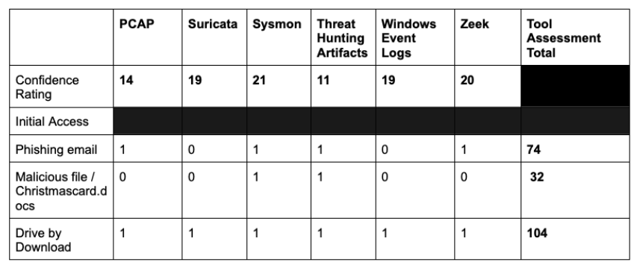
Updated Confidence Matrix (Tool Assessment component)

Slide 25
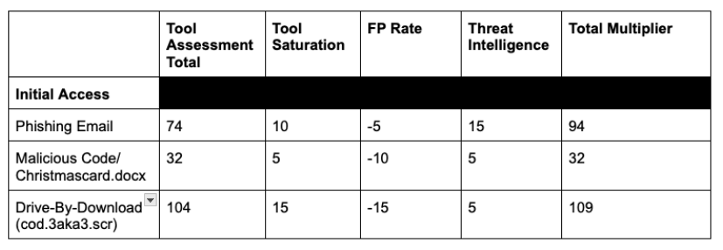
Updated Confidence Matrix Weights

Slide 26
Recommendations, take aways
Further divide the heatmaps by subnets and LANs.
Can apply these analysis against the entire MITRE ATT&CK Framework.
Will help understand the weaknesses in the organization's defensive setup.

Slide 27
References
Milan, H. Sardana, and Kamalpreet Singh. "Reducing false alarms in intrusion detection systems–a survey." International Research Journal of Engineering and Technology (IRJET) e-ISSN 2395 (2018): 0056.
Sans Incident Response (IR) Survey: Time to Change
Verizon Data Breach Investigations Report
Data-Driven Threat Hunting Using Sysmon

Slide 28
References
Performance Evaluation of Snort and Suricata Intrusion Detection Systems on Ubuntu Server
Refinement in Zeek Intrusion System
Evaluating the Efficacy of Network Forensic Tools: A Comparative Analysis of Snort, Suricata, and Zeek in Addressing Cyber Vulnerabilities
Rate of False Positives as a Security Performance Measure
All Eyes on PCAP: The Gold Standard of Traffic Analysis
Windows Event Forwarding for Network Defense

